Slide 1
The Development Resilience Approach
Chris Barrett, Jenn Cissé, Joanna Upton
Cornell University
April 18, 2017
Feinstein International Center, Tufts University
Resilience Measurement Think Shop

Slide 2
Development Resilience Approach
Based on Barrett & Constas (PNAS 2014)
Probabilistic approach to estimating stochastic well-being dynamics
Like poverty estimation, an explicitly normative approach based on assumed
(i) Level – Minimum acceptable standard of ‘adequate well-being’ (outcome) for an individual or household.
(ii) Probability – Minimum acceptable likelihood of meeting level

Slide 3
- In order to evaluate, must first be able to measure (if observable) or estimate (if unobservable). - Estimate conditional moments of the well-being outcome variable, as a function of variables reflecting (i) exogenous shocks (e.g., drought, illness, cyclone) (ii) conditioners of exposure, recovery (e.g., gender) (iii) interventions (iv) polynomial lags of DV (i.e., nonlinear dynamics) - Describe and predict time path of resilience for individuals of aggregates of individuals
Estimating Resilience

Slide 4
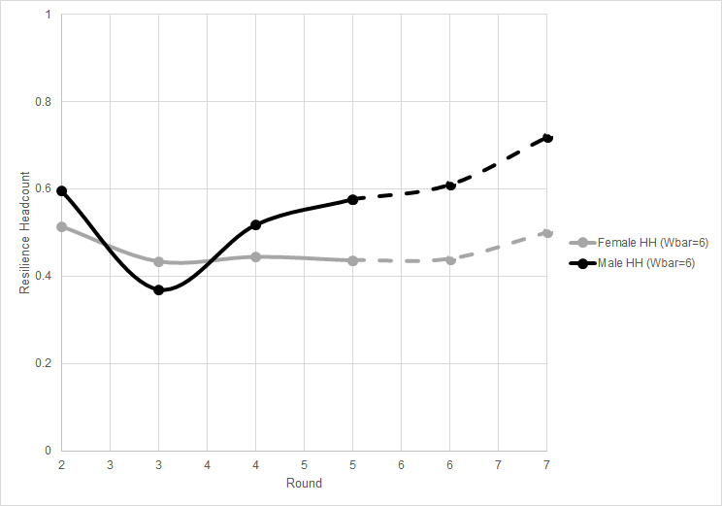
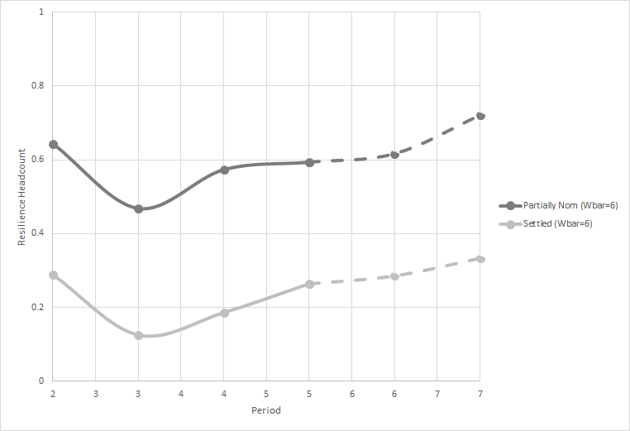
By gender of HH head By HH mobility
Examples from northern Kenya pastoralists

Slide 5
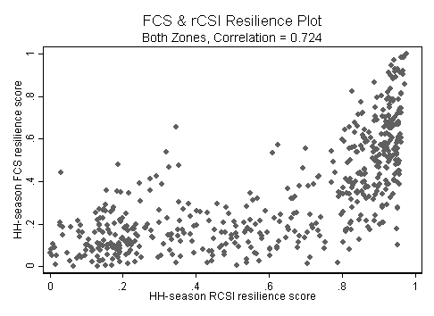
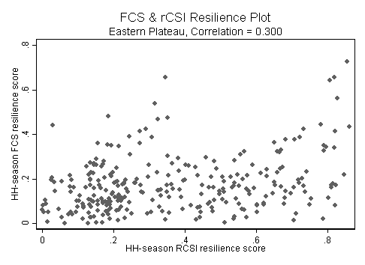
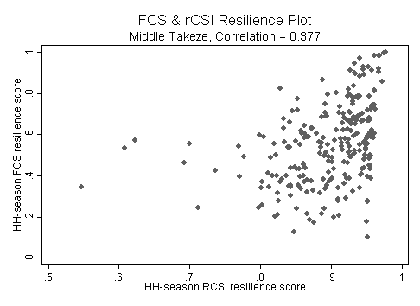
Extension: Food security & resilience in Tigray (Maxwell, Vaitla, Cissé, and Upton)
Building on Livelihood Change over Time study (Feinstein & Makelle University)
Four rounds of data over two years (~300 hhs), Tsaeda Amba & Seharti Samre woredas
Explore relationship between food security indicators (FCS & RCSI), and examine thresholds
Confirm that indicators capture different dimensions (combining regions is deceptive)
Changing thresholds has some effect on interpretation…

Slide 6
Extension: Food security & resilience in Tigray (Maxwell, Vaitla, Cissé, and Upton)

Slide 7
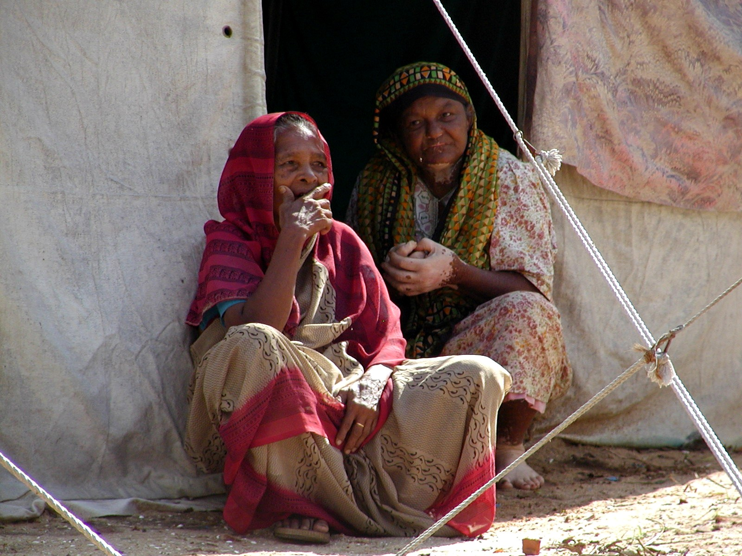
Thank you for your time and interest!

